Slide 1
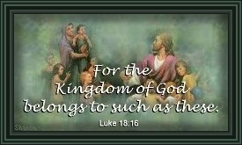
Morning Offering
Grace At Meals
The Mysteries of the Rosary
Act Of Sorrow
Stations Of The Cross
School Prayer
Glory Be To The Father
The Lord's Prayer
Hail Mary
Confetior
Blessings
Guardian Angel
A Child's Prayer For Morning

Slide 2
Morning Offering
O God my Father and Mother who is everywhere
I offer you myself and all I do this day.
Intentions for the day ....
Lord hear us
Lord hear our prayer

Slide 3
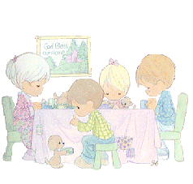
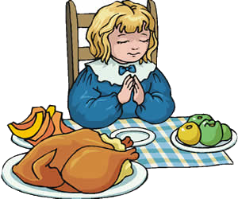
Grace At Meals
Before Meals
Bless us, O Lord! and these your gifts, which we
are about to receive , through Christ our Lord.
Amen.
After Meals
We give you thanks for all your benefits, O Almighty God, who lives and reigns world without end. Amen.
Before Meals
Bless us O Lord, and bless this food,
bless those who made it for us.
Make us truely thankful, through Christ our Lord.
Amen.
After Meals
We give you thanks for all your benefits, O Almighty God, who lives and reigns world without end. Amen.

Slide 4
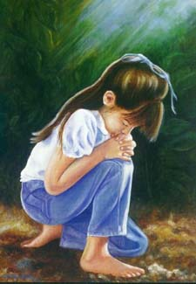
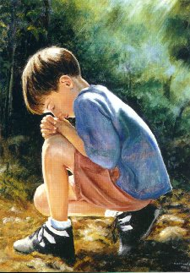
Act Of Sorrow
Oh my God,
I am very sorry that I have sinned against you,
because you are so good
and with your help
I will try not to sin again.

Slide 5
School Prayer
Dear Lord,
Look after everyone at St Joseph's School. St Joseph you looked Mary and Jesus please watch over us.
Help us to achieve our goals
and be good friends to all.
We ask this through Jesus Christ our Lord.
Amen.

Slide 6
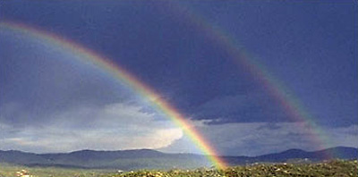
Glory Be To The Father
Glory be to the Father,
and to the Son,
and to the Holy Spirit.
This is usually the last prayer we say. It's like a cheer for God who is so good: “Hooray for God, whom Jesus tells us is Father, Son, and Holy Spirit.”
As it was in the beginning,
is now and ever shall be world without end.
“Hooray for God, who made things good from the beginning, when everything was new.”
“Hooray for God, who is good right now and holds us in his hands.”
“Hooray for God, whose goodness never fails. Every new day God surprises us with gifts we never expect.”
And we say
Amen to that.

Slide 7
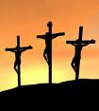
The Lord's Prayer
Our Father, who art in heaven,
Hallowed be thy Name.
Thy kingdom come.
Thy will be done,
On earth as it is in heaven.
Give us this day our daily bread.
And forgive us our trespasses,
As we forgive those who trespass against us.
And lead us not into temptation,
But deliver us from evil.
Amen.

Slide 8
Hail Mary
Hail Mary,
Full of Grace,
The Lord is with thee.
Blessed art thou among women,
and blessed is the fruit
of thy womb, Jesus.
Holy Mary,
Mother of God,
pray for us sinners now,
and at the hour of death.
Amen.

Slide 9
Confeitor
I confess to almighty God,
and to you, my brothers and sisters,
that I have sinned through my own fault,
in my thoughts and in my words,
in what I have done,
and in what I have failed to do;
and I ask Blessed Mary, ever Virgin,
all the angels and saints,
and you, my brothers and sisters,
to pray for me to the Lord our God.
The Confetior is the commual confession of sin during the Mass. As with the Sign of the Cross there are also gestures (now forgotten) to the prayer. At "my fault" you are to beat your breast. At the finale part you make a sign of the cross; touch on "pardon", "absolution", "remission", and "sins". And this pary part for group prayer.

Slide 10
Blessings

Slide 11
Guardian Angel
Angel of God, my Guardian Dear
To whom His love commits me here
Ever this day, be at my side,
To light and guard
To rule and guide.
Amen

Slide 12
A Child's Prayer For Morning
My God, I offer to You this day all I think or do or say, in union with all You have done for me by Jesus Christ Your Son. Amen.
Dear Lord, I rise from bed to pray; then
soon go out to school or play. Let all I meet along the way see You in me throughout the day.
Amen.

